Slide 1
Executive Portfolio Health Review
AI-Powered Project Health Reporting
Reporting Period: Monthly Portfolio Review
Prepared by
Ankush Yadav

Slide 2
Portfolio Health Snapshot
Portfolio Metric | Value
Total Projects | 2
🟢 Green Projects | 0
🟠 Amber Projects | 1
🔴 Red Projects | 1
⚠ Data Quality Alerts | 1
Key Observations
Both projects triggered the RED status based on the defined RAG framework.
Schedule execution and budget governance are the primary portfolio risks.
One project contains incomplete financial information, reducing reporting confidence.
Early intervention is required to prevent further delivery and financial impact.
Overall Portfolio Health: 🔴 Critical

Slide 3
Portfolio Risk Trends & Analysis
Trend 1 📅
Schedule Risk is Increasing
Alpha experienced significant schedule slippage.
Delays may affect downstream milestones.
Trend 2 💰
Budget Overspend Emerging
Beta exceeded allocated budget.
Cost control mechanisms require closer monitoring.
Trend 3 🤝
Stakeholder Confidence is Declining
Negative client sentiment detected in Alpha.
Communication and recovery planning should be prioritized.
Trend 4 📄
Data Quality Issues
Missing financial information identified.
AI logged incomplete fields instead of failing analysis.
The portfolio demonstrates increasing operational and financial risks despite successful automated monitoring.

Slide 4
Emerging Risks Identified by the AI Agent
Risk | Portfolio Impact | Priority
Schedule Slippage | Delayed project delivery | 🔴 High
Budget Overrun | Increased project cost | 🔴 High
Stakeholder Dissatisfaction | Lower client confidence | 🔴 High
Missing Project Data | Reduced reporting accuracy | 🟠 Medium
AI Risk Assessment
The AI agent identified common risk patterns affecting multiple projects:
Delivery execution
Budget management
Client satisfaction
Data completeness
Without timely corrective action, these risks may significantly affect delivery performance and customer satisfaction.

Slide 5
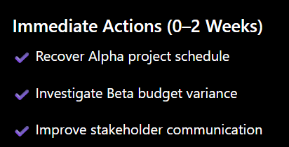
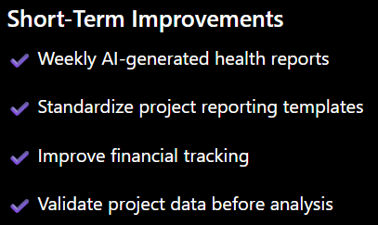
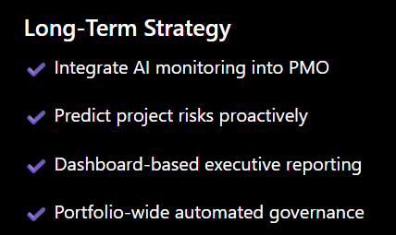
Executive Recommendations
Proactive monitoring is significantly less expensive than reactive recovery.

Slide 6
Business Value Delivered
Before AI Agent | After AI Agent
Manual project reviews | Automated weekly analysis
Inconsistent RAG decisions | Standardized scoring framework
Delayed executive visibility | Instant health reporting
Manual risk tracking | AI-generated insights
Poor data transparency | Automatic data gap detection
Key Benefits
✅ Automated portfolio monitoring
✅ Consistent RAG evaluation
✅ Explainable AI recommendations
✅ Graceful handling of incomplete data
✅ Historical report generation
The Project Health Reporting Agent enables leadership to identify delivery risks earlier, improve project governance, and make faster, data-driven decisions through automated AI-powered health assessments.

Slide 7
Conclusion
The portfolio assessment identified critical delivery and financial risks that require immediate leadership attention. While the projects face different challenges, the AI-powered reporting framework successfully identified high-priority issues, explained their business impact, and highlighted areas requiring corrective action.
The analysis also demonstrated that automated health reporting can provide consistent, transparent, and timely project evaluations without relying on manual reviews.
Immediate Priorities
✔ Stabilize project delivery through schedule recovery planning.
✔ Improve budget governance and financial monitoring.
✔ Strengthen stakeholder communication to restore confidence.
✔ Standardize project data quality across engagements.
Strategic Recommendation
Implement the AI Project Health Reporting Agent as part of the weekly PMO governance process to provide:
Automated portfolio health assessments
Early risk detection and escalation
Consistent executive reporting
Improved decision-making through explainable AI insights

